Slide 1
CHAPTER 12
FUZZY RULE BASE AND APPROXIMATE REASONING
“Principles of Soft Computing, 2nd Edition”
by S.N. Sivanandam & SN Deepa
Copyright © 2011 Wiley India Pvt. Ltd. All rights reserved.

Slide 2
FUZZY RULES AND REASONING
  The degree of an element in a fuzzy set corresponds to the truth value of a proposition in fuzzy logic systems.
“Principles of Soft Computing, 2nd Edition”
by S.N. Sivanandam & SN Deepa
Copyright © 2011 Wiley India Pvt. Ltd. All rights reserved.

Slide 3
LINGUISTIC VARIABLES
A linguistic variable is a fuzzy variable.
The linguistic variable speed ranges between 0 and 300 km/h and includes the fuzzy sets slow, very slow, fast, …
Fuzzy sets define the linguistic values.
Hedges are qualifiers of a linguistic variable.
All purpose: very, quite, extremely
Probability: likely, unlikely
Quantifiers: most, several, few
Possibilities: almost impossible, quite possible
“Principles of Soft Computing, 2nd Edition”
by S.N. Sivanandam & SN Deepa
Copyright © 2011 Wiley India Pvt. Ltd. All rights reserved.

Slide 4
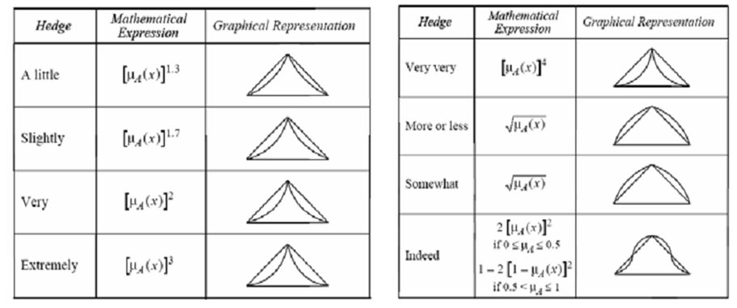
LINGUISTIC HEDGES (LINGUISTIC QUANTIFIERS)
Hedges modify the shape of a fuzzy set.
“Principles of Soft Computing, 2nd Edition”
by S.N. Sivanandam & SN Deepa
Copyright © 2011 Wiley India Pvt. Ltd. All rights reserved.

Slide 5
TRUTH TABLES
Truth tables define logic functions of two propositions. Let X and Y be two propositions, either of which can be true or false.
The operations over the propositions are:
Conjunction (∧): X AND Y.
Disjunction (∨): X OR Y.
Implication or conditional (⇒): IF X THEN Y.
Bidirectional or equivalence (⇔): X IF AND ONLY IF Y.
“Principles of Soft Computing, 2nd Edition”
by S.N. Sivanandam & SN Deepa
Copyright © 2011 Wiley India Pvt. Ltd. All rights reserved.

Slide 6
FUZZY RULES
A fuzzy rule is defined as the conditional statement of the form
If x is A
THEN y is B
where x and y are linguistic variables and A and B are linguistic values determined by fuzzy sets on the universes of discourse X and Y.
“Principles of Soft Computing, 2nd Edition”
by S.N. Sivanandam & SN Deepa
Copyright © 2011 Wiley India Pvt. Ltd. All rights reserved.

Slide 7
The decision-making process is based on rules with sentence conjunctives AND, OR and ALSO.
Each rule corresponds to a fuzzy relation.
Rules belong to a rule base.
Example: If (Distance x to second car is SMALL) OR (Distance y to obstacle is CLOSE) AND (speed v is HIGH) THEN (perform LARGE correction to steering angle θ) ALSO (make MEDIUM reduction in speed v).
Three antecedents (or premises) in this example give rise to two outputs (consequences).
“Principles of Soft Computing, 2nd Edition”
by S.N. Sivanandam & SN Deepa
Copyright © 2011 Wiley India Pvt. Ltd. All rights reserved.

Slide 8
FUZZY RULE FORMATION
IF height is tall
THEN weight is heavy.
Here the fuzzy classes height and weight have a given range (i.e., the universe of discourse).
range (height) = [140, 220]
range (weight) = [50, 250]
“Principles of Soft Computing, 2nd Edition”
by S.N. Sivanandam & SN Deepa
Copyright © 2011 Wiley India Pvt. Ltd. All rights reserved.

Slide 9
FORMATION OF FUZZY RULES
Three general forms are adopted for forming fuzzy rules. They are:
Assignment statements,
Conditional statements,
Unconditional statements.
“Principles of Soft Computing, 2nd Edition”
by S.N. Sivanandam & SN Deepa
Copyright © 2011 Wiley India Pvt. Ltd. All rights reserved.

Slide 10
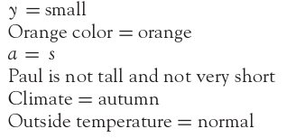
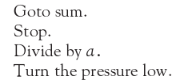

Assignment Statements
Unconditional Statements
Conditional Statements
“Principles of Soft Computing, 2nd Edition”
by S.N. Sivanandam & SN Deepa
Copyright © 2011 Wiley India Pvt. Ltd. All rights reserved.

Slide 11
DECOMPOSITION OF FUZZY RULES
A compound rule is a collection of several simple rules combined together.
Multiple conjunctive antecedent,
Multiple disjunctive antecedent,
Conditional statements (with ELSE and UNLESS).
“Principles of Soft Computing, 2nd Edition”
by S.N. Sivanandam & SN Deepa
Copyright © 2011 Wiley India Pvt. Ltd. All rights reserved.

Slide 12
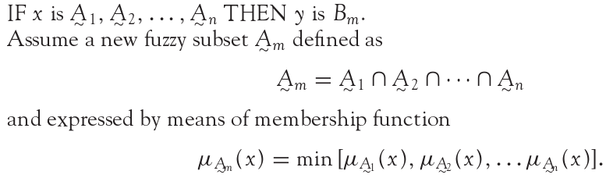
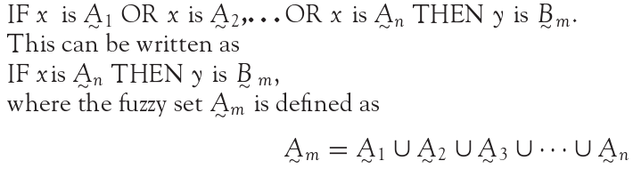
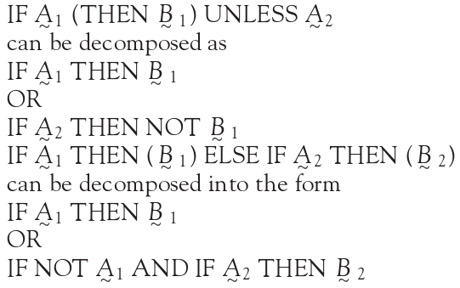
DECOMPOSITION OF FUZZY RULES
Multiple Conjunctive
Antecedants
Multiple disjunctive
antecedent
Conditional Statements ( With Else and Unless)
“Principles of Soft Computing, 2nd Edition”
by S.N. Sivanandam & SN Deepa
Copyright © 2011 Wiley India Pvt. Ltd. All rights reserved.

Slide 13
AGGREGATION OF FUZZY RULES
Aggregation of rules is the process of obtaining the overall consequents from the individual consequents provided by each rule.
Conjunctive system of rules.
Disjunctive system of rules.
“Principles of Soft Computing, 2nd Edition”
by S.N. Sivanandam & SN Deepa
Copyright © 2011 Wiley India Pvt. Ltd. All rights reserved.

Slide 14
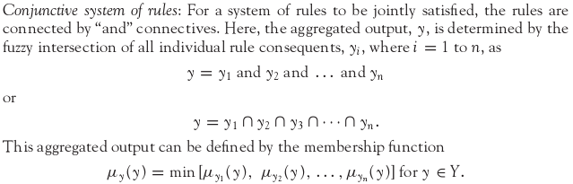
AGGREGATION OF FUZZY RULES
Conjunctive system of rules
“Principles of Soft Computing, 2nd Edition”
by S.N. Sivanandam & SN Deepa
Copyright © 2011 Wiley India Pvt. Ltd. All rights reserved.

Slide 15
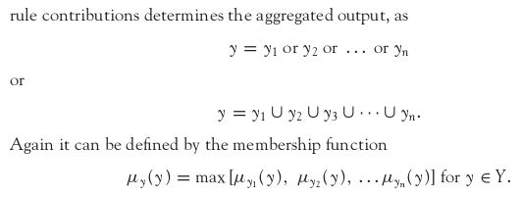
Disjunctive system of rules
“Principles of Soft Computing, 2nd Edition”
by S.N. Sivanandam & SN Deepa
Copyright © 2011 Wiley India Pvt. Ltd. All rights reserved.

Slide 16
FUZZY RULE - EXAMPLE
Rule 1: If height is short then weight is light.
Rule 2: If height is medium then weight is medium.
Rule 3: If height is tall then weight is heavy.
“Principles of Soft Computing, 2nd Edition”
by S.N. Sivanandam & SN Deepa
Copyright © 2011 Wiley India Pvt. Ltd. All rights reserved.

Slide 17
Problem: Given
(a) membership functions for short, medium-height, tall, light, medium-weight and heavy;
(b) The three fuzzy rules;
the fact that John’s height is 6’1”
estimate John’s weight.
“Principles of Soft Computing, 2nd Edition”
by S.N. Sivanandam & SN Deepa
Copyright © 2011 Wiley India Pvt. Ltd. All rights reserved.

Slide 18
Solution:
(1) From John’s height we know that
John is short (degree 0.3)
John is of medium height (degree 0.6).
John is tall (degree 0.2).
(2) Each rule produces a fuzzy set as output by truncating the consequent membership function at the value of the antecedent membership.
“Principles of Soft Computing, 2nd Edition”
by S.N. Sivanandam & SN Deepa
Copyright © 2011 Wiley India Pvt. Ltd. All rights reserved.

Slide 19
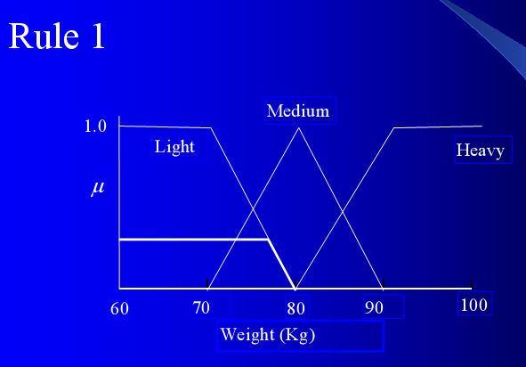
“Principles of Soft Computing, 2nd Edition”
by S.N. Sivanandam & SN Deepa
Copyright © 2011 Wiley India Pvt. Ltd. All rights reserved.

Slide 20
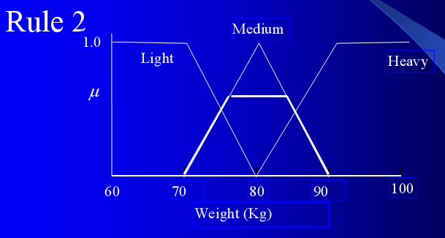
“Principles of Soft Computing, 2nd Edition”
by S.N. Sivanandam & SN Deepa
Copyright © 2011 Wiley India Pvt. Ltd. All rights reserved.

Slide 21
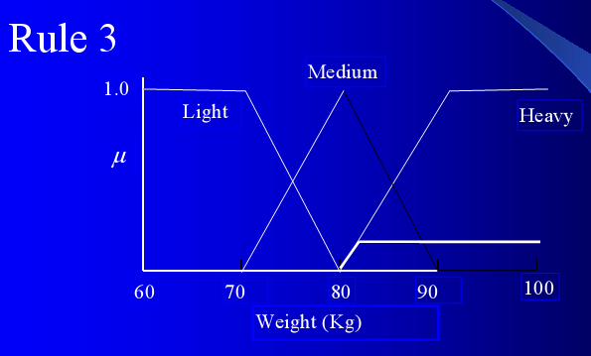
“Principles of Soft Computing, 2nd Edition”
by S.N. Sivanandam & SN Deepa
Copyright © 2011 Wiley India Pvt. Ltd. All rights reserved.

Slide 22
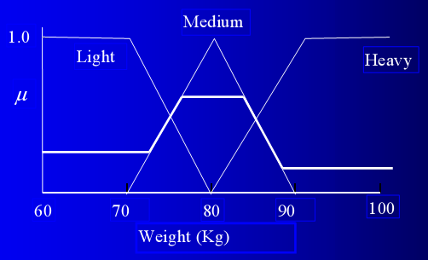
The cumulative fuzzy output is obtained by OR-ing the output from each rule.
Cumulative fuzzy output (weight at 6’1”).
“Principles of Soft Computing, 2nd Edition”
by S.N. Sivanandam & SN Deepa
Copyright © 2011 Wiley India Pvt. Ltd. All rights reserved.

Slide 23
De-fuzzify to obtain a numerical estimate of the output.
Choose the middle of the range where the truth value is maximum.
John’s weight = 80 Kg.
“Principles of Soft Computing, 2nd Edition”
by S.N. Sivanandam & SN Deepa
Copyright © 2011 Wiley India Pvt. Ltd. All rights reserved.

Slide 24
FUZZY REASONING
There exist four modes of fuzzy approximate reasoning, which include:
Categorical reasoning,
Qualitative reasoning,
Syllogistic reasoning,
Dispositional reasoning.
“Principles of Soft Computing, 2nd Edition”
by S.N. Sivanandam & SN Deepa
Copyright © 2011 Wiley India Pvt. Ltd. All rights reserved.

Slide 25
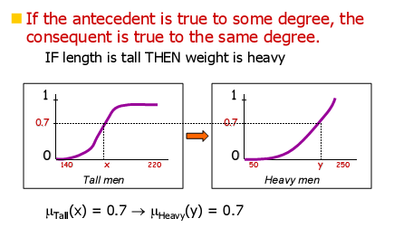
REASONING WITH FUZZY RULES
In classical systems, rules with true antecedents fire.
In fuzzy systems, truth (i.e., membership in some class) is relative, so all rules fire (to some extent).
“Principles of Soft Computing, 2nd Edition”
by S.N. Sivanandam & SN Deepa
Copyright © 2011 Wiley India Pvt. Ltd. All rights reserved.

Slide 26
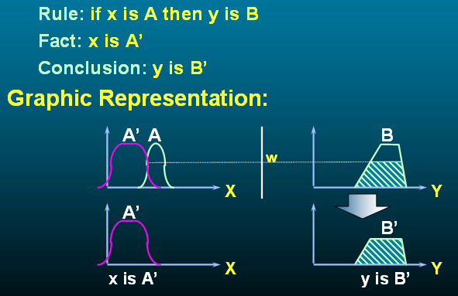
SINGLE RULE WITH SINGLE ANTECEDANT
“Principles of Soft Computing, 2nd Edition”
by S.N. Sivanandam & SN Deepa
Copyright © 2011 Wiley India Pvt. Ltd. All rights reserved.

Slide 27
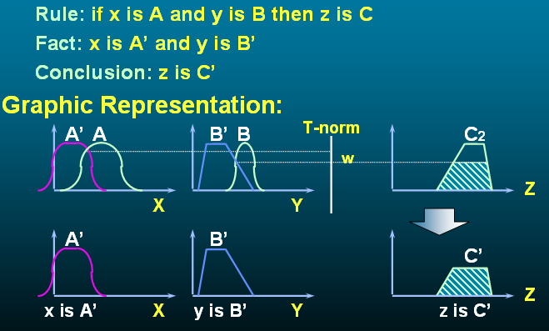
“Principles of Soft Computing, 2nd Edition”
by S.N. Sivanandam & SN Deepa
Copyright © 2011 Wiley India Pvt. Ltd. All rights reserved.

Slide 28
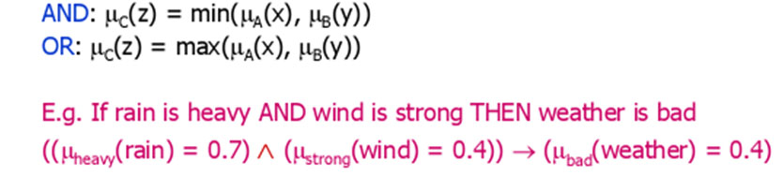
MULTIPLE ANTECEDANTS
IF x is A AND y is B THEN z is C
IF x is A OR y is B THEN z is C
Use unification (OR) or intersection (AND) operations to calculate a membership value for the whole antecedent.
“Principles of Soft Computing, 2nd Edition”
by S.N. Sivanandam & SN Deepa
Copyright © 2011 Wiley India Pvt. Ltd. All rights reserved.

Slide 29
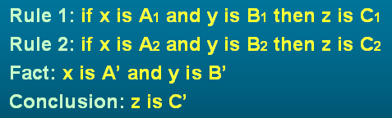
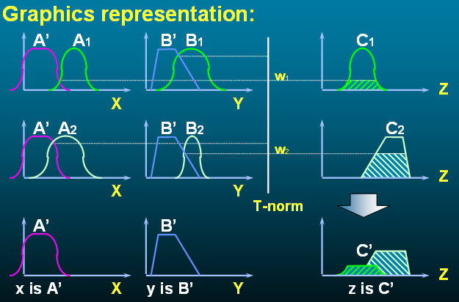
MULTIPLE RULE WITH MULTIPLE ANTECEDANTS
“Principles of Soft Computing, 2nd Edition”
by S.N. Sivanandam & SN Deepa
Copyright © 2011 Wiley India Pvt. Ltd. All rights reserved.

Slide 30
MULTIPLE CONSEQUENTS
IF x is A THEN y is B AND z is C
Each consequent is affected equally by the membership in the antecedent class(es).
E.g., IF x is tall THEN x is heavy AND x has large feet.
“Principles of Soft Computing, 2nd Edition”
by S.N. Sivanandam & SN Deepa
Copyright © 2011 Wiley India Pvt. Ltd. All rights reserved.

Slide 31
FUZZY INFERENCE SYSTEMS (FIS)
Fuzzy rule based systems, fuzzy models, and fuzzy expert systems are also known as fuzzy inference systems.
The key unit of a fuzzy logic system is FIS.
The primary work of this system is decision-making.
FIS uses “IF...THEN” rules along with connectors “OR” or “AND” for making necessary decision rules.
The input to FIS may be fuzzy or crisp, but the output from FIS is always a fuzzy set.
When FIS is used as a controller, it is necessary to have crisp output.
Hence, there should be a defuzzification unit for converting fuzzy variables into crisp variables along FIS.
“Principles of Soft Computing, 2nd Edition”
by S.N. Sivanandam & SN Deepa
Copyright © 2011 Wiley India Pvt. Ltd. All rights reserved.

Slide 32
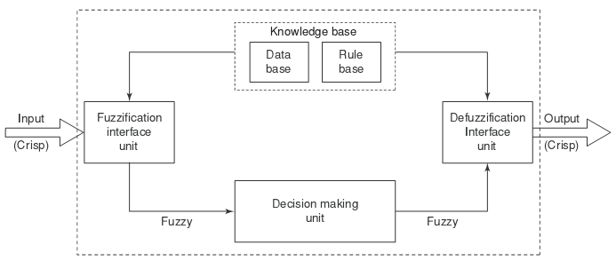
BLOCK DIAGRAM OF FIS
“Principles of Soft Computing, 2nd Edition”
by S.N. Sivanandam & SN Deepa
Copyright © 2011 Wiley India Pvt. Ltd. All rights reserved.

Slide 33
TYPES OF FIS
There are two types of Fuzzy Inference Systems:
Mamdani FIS(1975)
Sugeno FIS(1985)
“Principles of Soft Computing, 2nd Edition”
by S.N. Sivanandam & SN Deepa
Copyright © 2011 Wiley India Pvt. Ltd. All rights reserved.

Slide 34
MAMDANI FUZZY INFERENCE SYSTEMS (FIS)
Fuzzify input variables:
Determine membership values.
Evaluate rules:
Based on membership values of (composite) antecedents.
Aggregate rule outputs:
Unify all membership values for the output from all rules.
Defuzzify the output:
COG: Center of gravity (approx. by summation).
“Principles of Soft Computing, 2nd Edition”
by S.N. Sivanandam & SN Deepa
Copyright © 2011 Wiley India Pvt. Ltd. All rights reserved.

Slide 35
SUGENO FUZZY INFERENCE SYSTEMS (FIS)
The main steps of the fuzzy inference process namely,
fuzzifying the inputs and
applying the fuzzy operator are exactly the same as in MAMDANI FIS.
The main difference between Mamdani’s and Sugeno’s methods is that Sugeno output membership functions are either linear or constant.
“Principles of Soft Computing, 2nd Edition”
by S.N. Sivanandam & SN Deepa
Copyright © 2011 Wiley India Pvt. Ltd. All rights reserved.

Slide 36
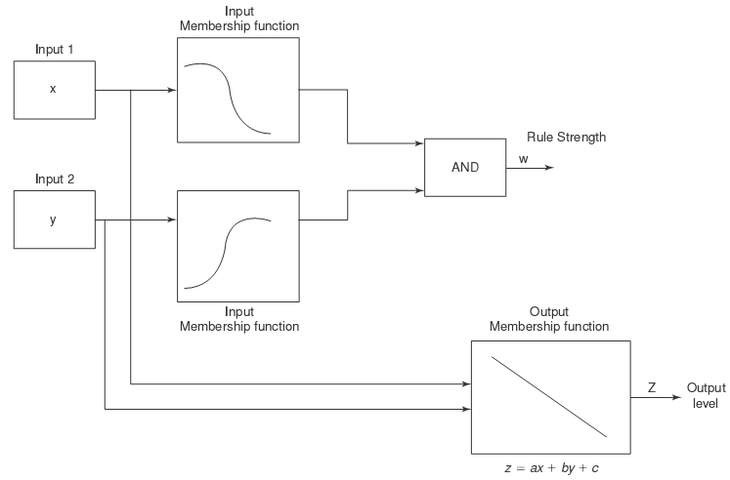
SUGENO FIS
“Principles of Soft Computing, 2nd Edition”
by S.N. Sivanandam & SN Deepa
Copyright © 2011 Wiley India Pvt. Ltd. All rights reserved.

Slide 37
FUZZY EXPERT SYSTEMS
An expert system contains three major blocks:
Knowledge base that contains the knowledge specific to the domain of application.
Inference engine that uses the knowledge in the knowledge base for performing suitable reasoning for user’s queries.
User interface that provides a smooth communication between the user and the system.
“Principles of Soft Computing, 2nd Edition”
by S.N. Sivanandam & SN Deepa
Copyright © 2011 Wiley India Pvt. Ltd. All rights reserved.

Slide 38
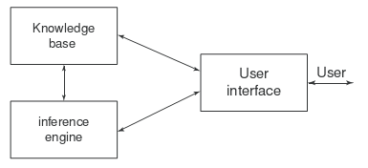
BLOCK DIAGRAM OF FUZZY EXPERT SYSTEMS
Examples of Fuzzy Expert System include Z-II, MILORD.
“Principles of Soft Computing, 2nd Edition”
by S.N. Sivanandam & SN Deepa
Copyright © 2011 Wiley India Pvt. Ltd. All rights reserved.

Slide 39
SUMMARY
Advantages of fuzzy logic
  Allows the use of vague linguistic terms in the rules.
Disadvantages of fuzzy logic
  Difficult to estimate membership function
  There are many ways of interpreting fuzzy rules, combining the outputs of several fuzzy rules and de-fuzzifying the output.
“Principles of Soft Computing, 2nd Edition”
by S.N. Sivanandam & SN Deepa
Copyright © 2011 Wiley India Pvt. Ltd. All rights reserved.

